Slide 1

TEXT CATEGORIZATION
(CLASSIFICATION)
-- Text representation --

Slide 2
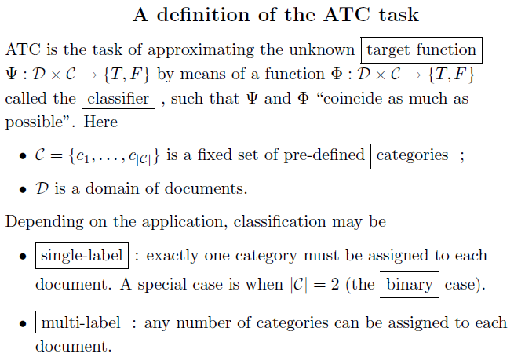
TEXT CLASSIFICATION (CATEGORIZATION)
– the assignment of natural language texts to one or more predefined categories (classes)
based on their content.
Automated text categorization (ATC)

Slide 3
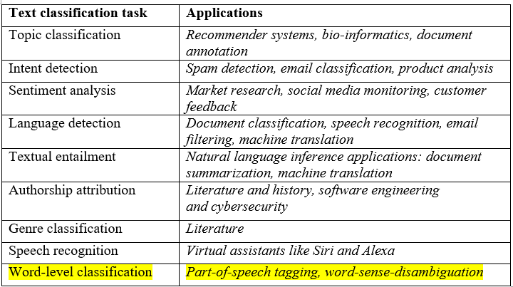
APPLICATIONS OF ATC

Slide 4
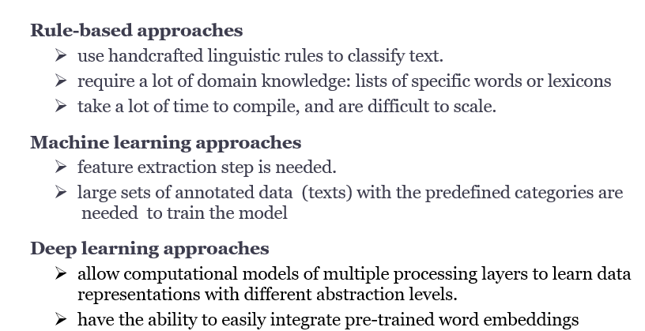
APPROACHES

Slide 5
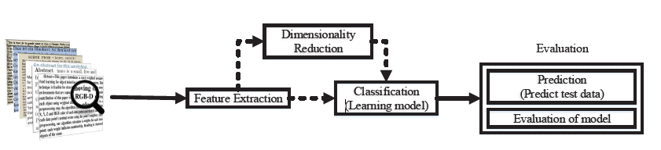
Machine learning approach
Supervised algorithms for binary and multi-class classification:
LR (Logistic regression)
SVM (Support vector machines)
KNN (K-nearest neighbors)
NB (Naïve Bayes)
DT (Decision trees)
RF (Random forest)
NN (Neural networks)

Slide 6
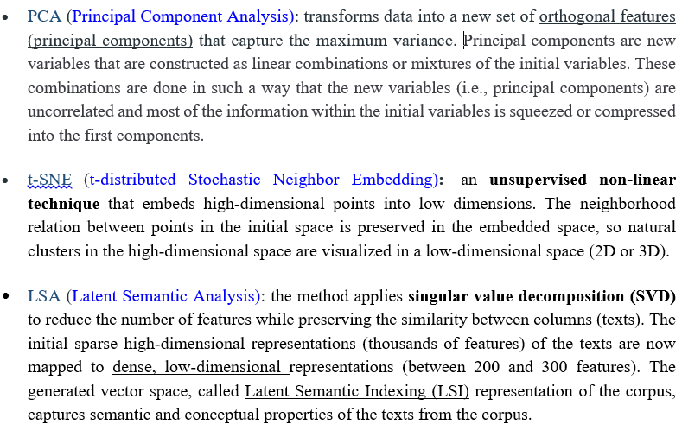
DIMENSIONALITY REDUCTION
Simplify datasets by reducing the number of features while retaining the most important information.

Slide 7
TEXT PRE-PROCESSING
Tokenization
Stop words removal
    words that are widely used but they carry very little useful information.
    Ex: {a, the, is, are, then, you, it, what,….}
Capitalization: reduce every letter to lower case
Slang and abbreviation: convert them into formal language
Noise removal: eliminate unnecessary characters (punctuation, special characters)
Stemming
POS -tagging
Lemmatization
Chunking
Dependency trees

Slide 8
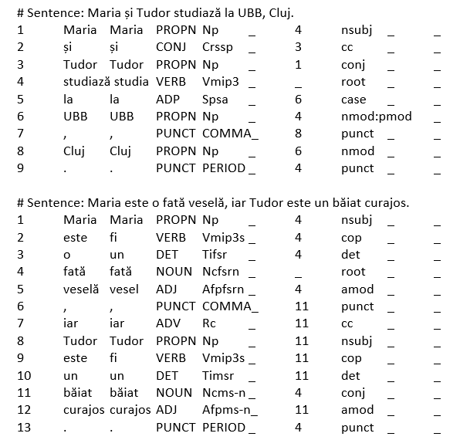
TEXT PRE-PROCESSING USING RELATE -TEPROLIN
Maria si Tudor studiaza la UBB, Cluj.
Maria este o fata vesela, iar Tudor este un baiat curajos.

Slide 9
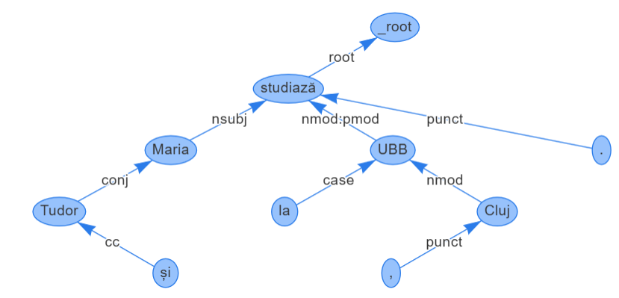
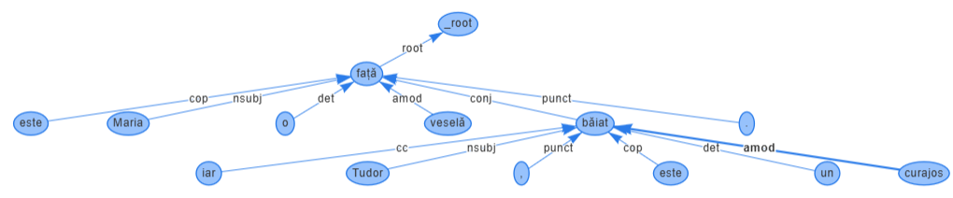
Dependency trees
Maria si Tudor studiaza la UBB, Cluj.
Maria este o fata vesela, iar Tudor este un baiat curajos.

Slide 10
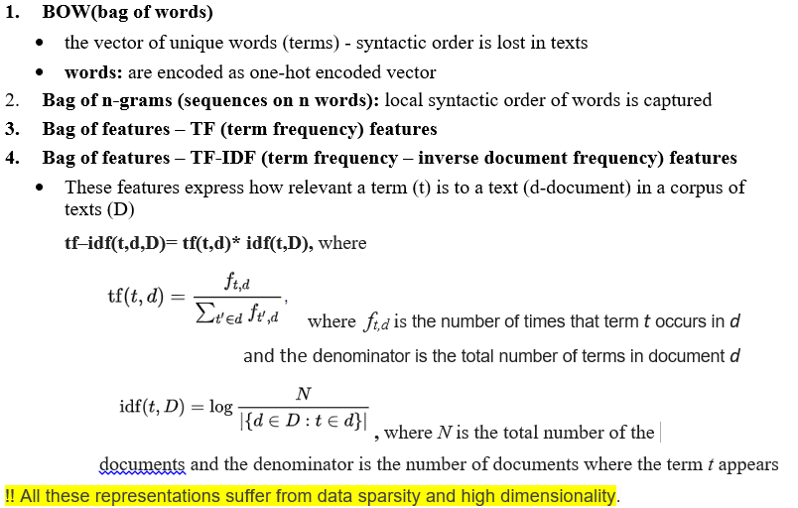
TEXT REPRESENTATION - SYNTACTIC FEATURES

Slide 11
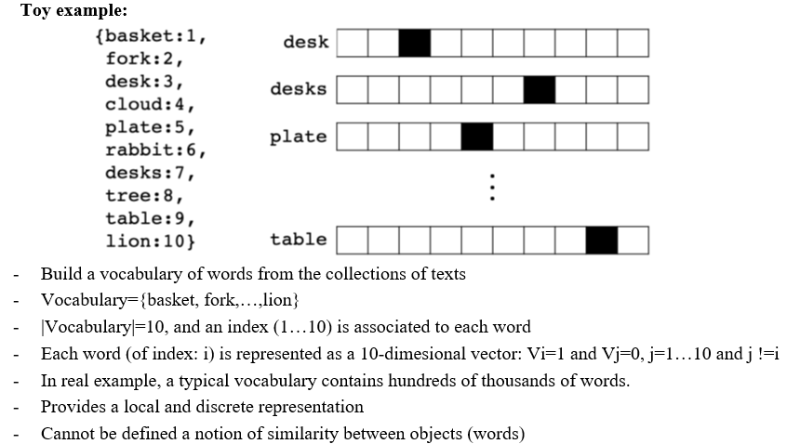
ONE-HOT REPRESENTATION –
THE SIMPLEST FORM OF WORD REPRESENTATION

Slide 12
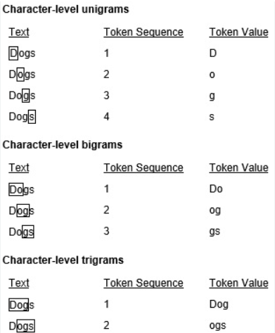
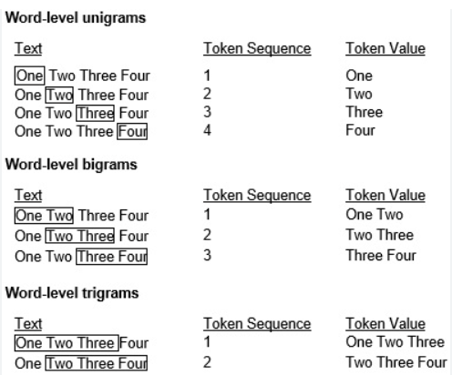
N-GRAM: A TOKEN SEQUENCE OF N ENTITIES IN A TEXT

Slide 13
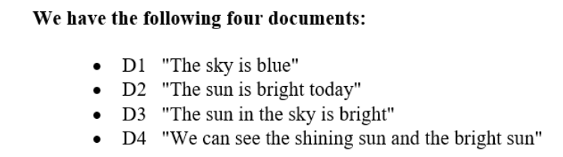
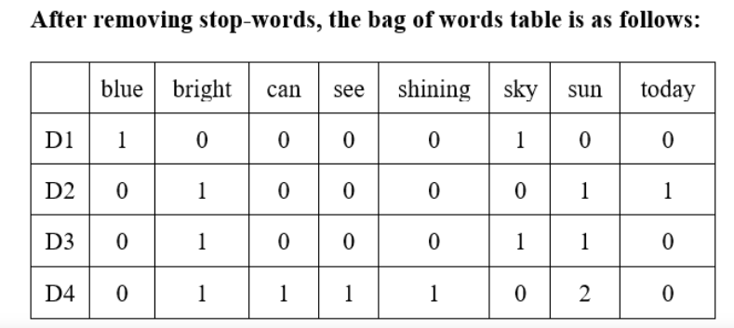
TEXT REPRESENTATIONS:
BAG-OF-WORDS AND BAG-OF-FEATURES (TERM FREQUENCY)

Slide 14


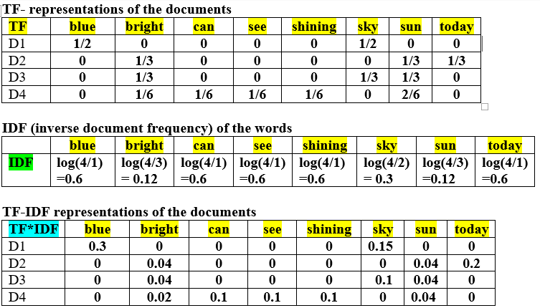
TF-IDF REPRESENTATIONS FOR THE SET OF DOCUMENTS, N=4

Slide 15
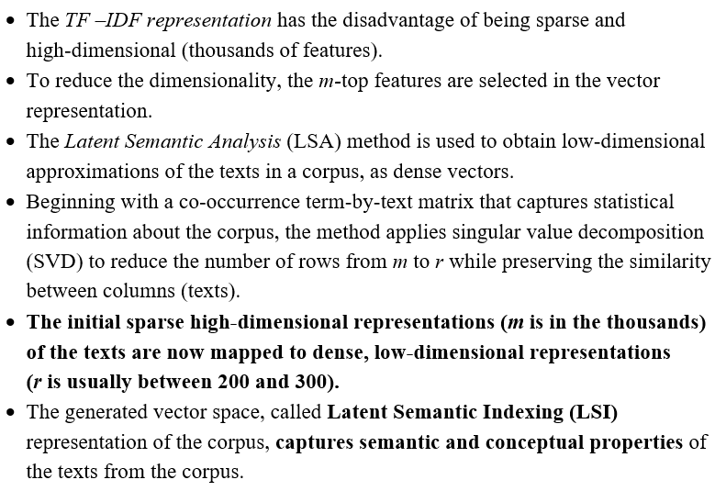
FEATURE TRANSFORMATION AND REDUCTION
- LATENT SEMANTIC INDEXING (LSI)

Slide 16
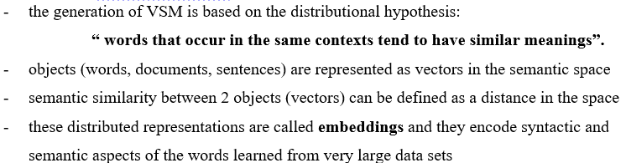
SEMANTIC REPRESENTATIONS - VECTOR SPACE MODELS (VSM)

Slide 17
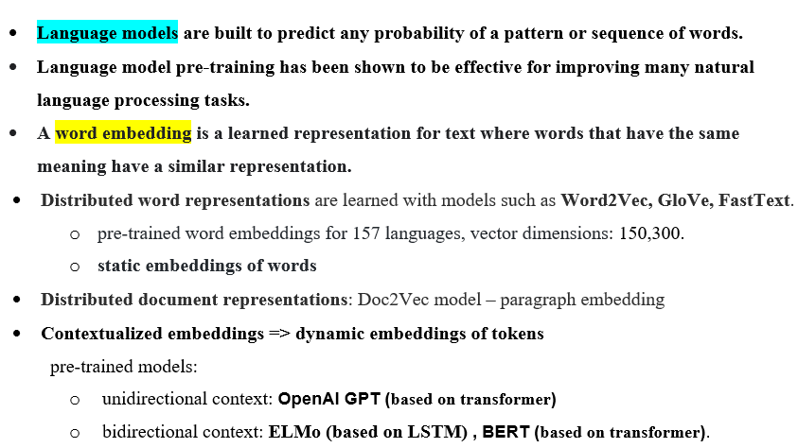
LANGUAGE MODELS

Slide 18
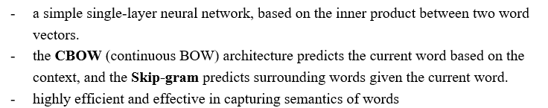
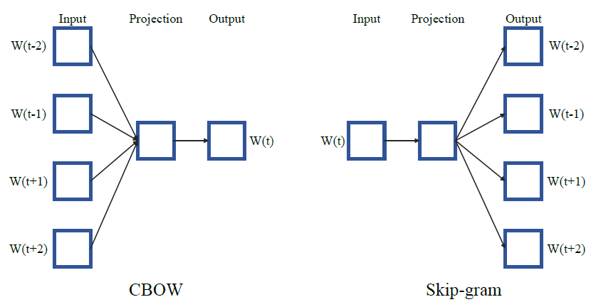
WORD2VEC MODEL

Slide 19
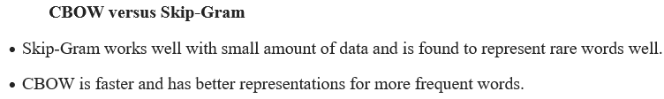
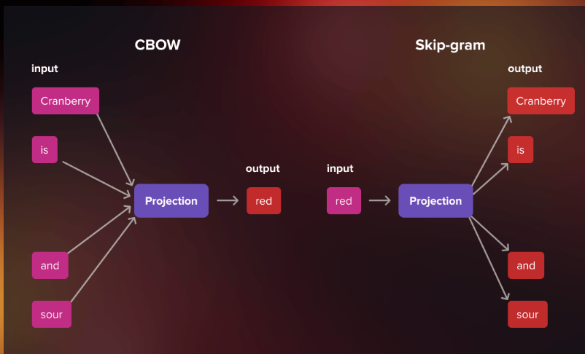
WORD2VEC

Slide 20
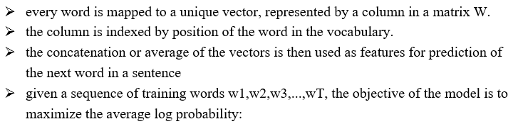
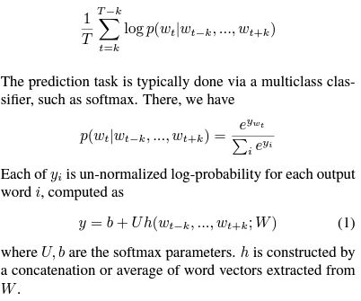
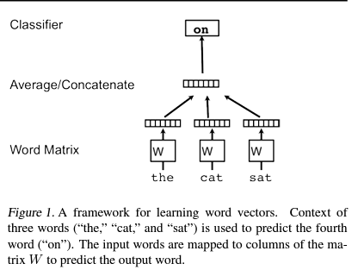
WORD2VEC

Slide 21
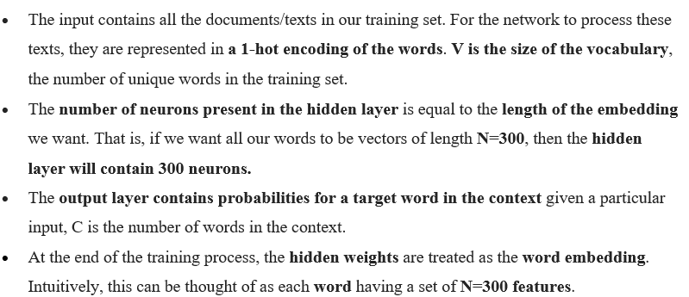
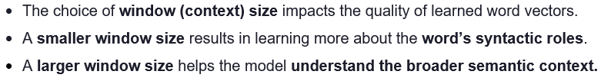
WORD2VEC - A SHALLOW NEURAL NETWORK

Slide 22
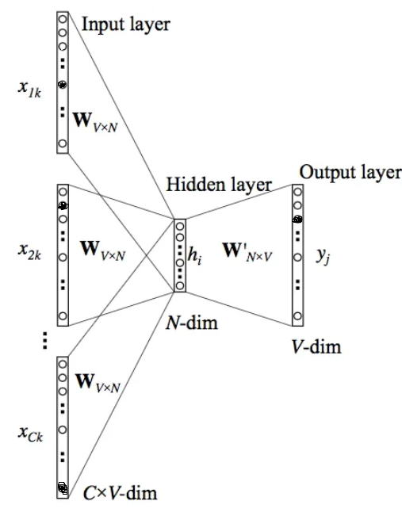
CBOW MODEL

Slide 23
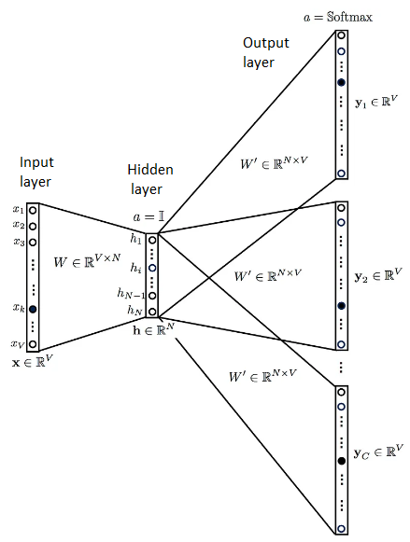
SKIP-GRAM MODEL

Slide 24
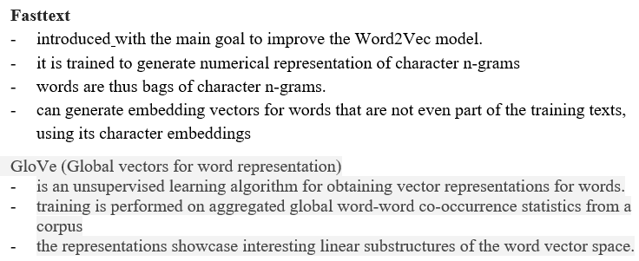
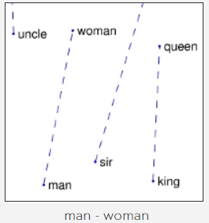
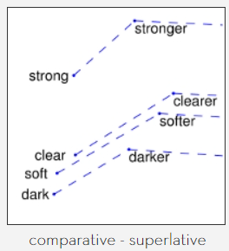

Slide 25
WORD2VEC --- FASTTEXT --- GLOVE
FastText tends to perform better for syntactic tasks.
Word2vec performs better for semantic tasks.
GloVe combines the benefits of matrix factorization techniques used in LSA with the local context window approach of Word2Vec, capturing both global and local context information, which enhances its ability to
discern semantic and syntactic similarities
between words.

Slide 26
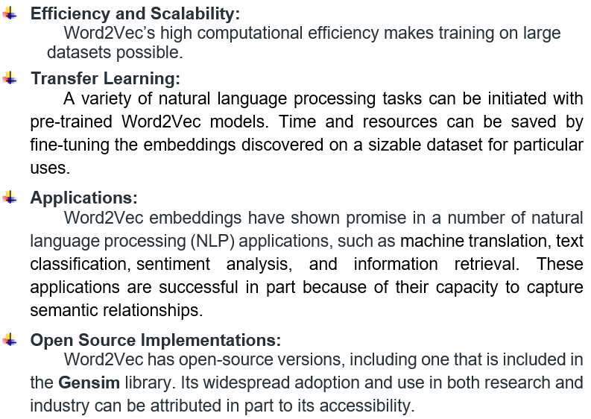
WORD2VEC

Slide 27
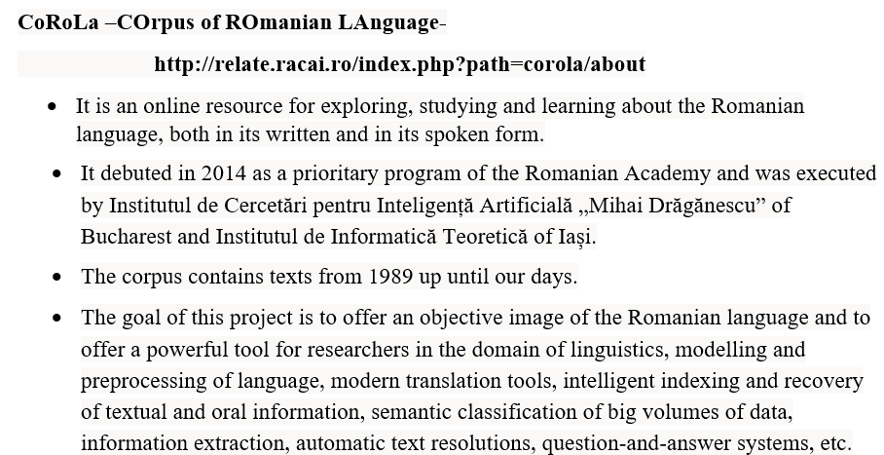

Slide 28
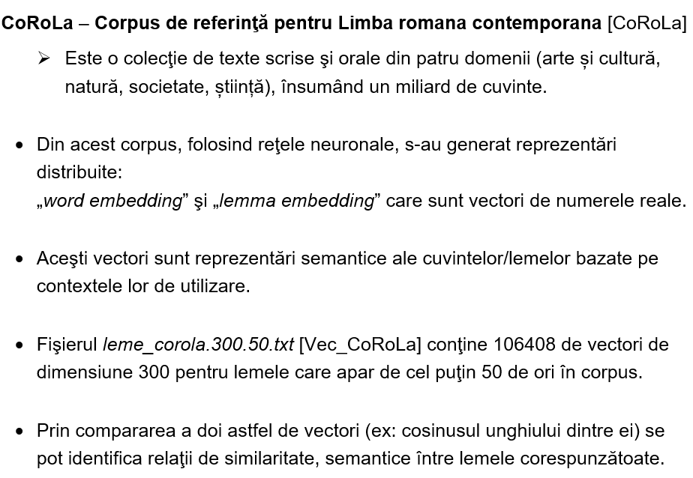

Slide 29
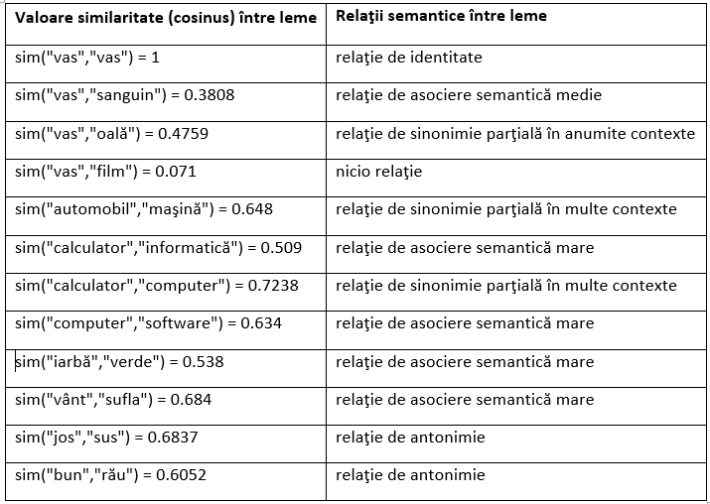
COROLA- SIMILARITATI

Slide 30
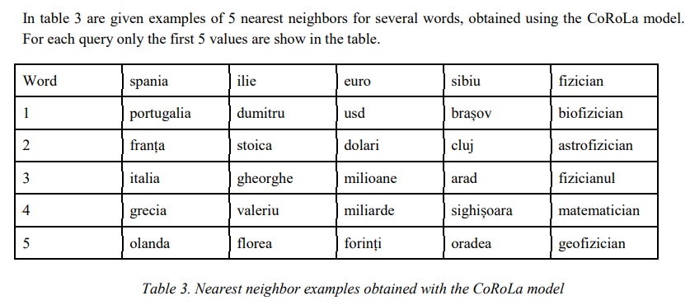
COROLA (CONT.)

Slide 31
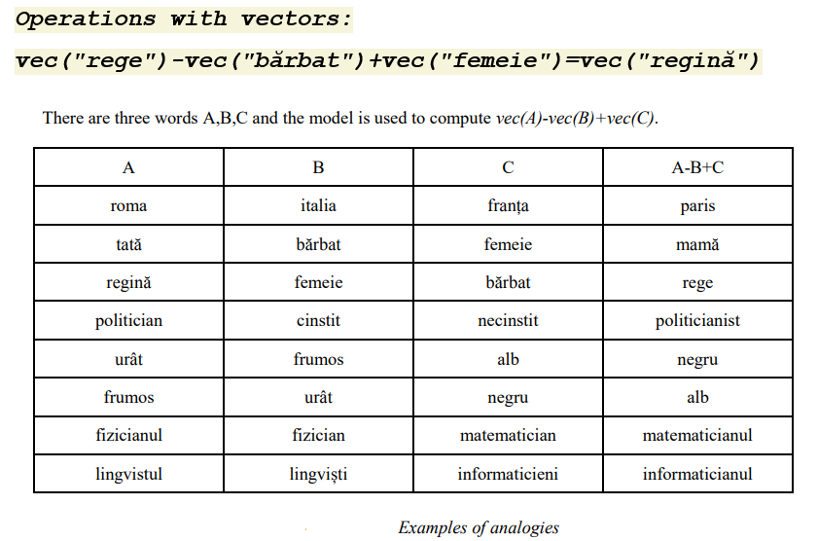
COROLA (CONT.)

Slide 32
COROLA – OPERATIONS WITH VECTORS
===> exemple de bază:
Profesor - barbat + femeie =profesoara
Studentă - femeie + bărbat =student
===>
Carne - animal + plantă = salată
===> Diferența dintre proză și poezie
Poezie - rimă + om = scriitor
Scriitor - om + rime = versuri
===> Noțiunea de vârstă:
Bătrân - timp + bărbat = tânăr
Bătrână - timp + femeie = fată
==> Noțiunea de profesie:
Muzician - muzică + pictură = pictor
Muzician - muzică + poezie = poet
Muzician - muzică + proză = sciitor
Muzician - muzică + gătit = bucătar

Slide 33
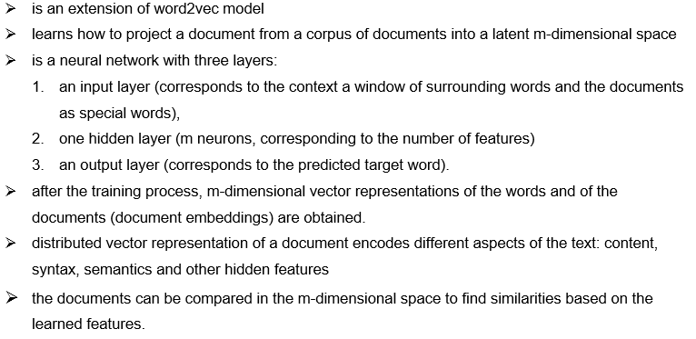
DOC2VEC (PARAGRAPH VECTOR) MODEL

Slide 34
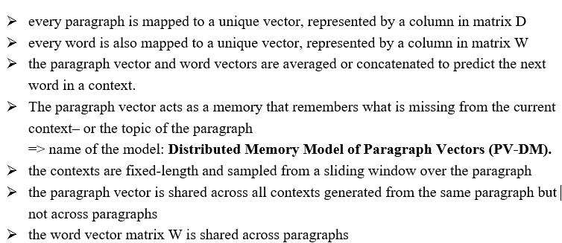
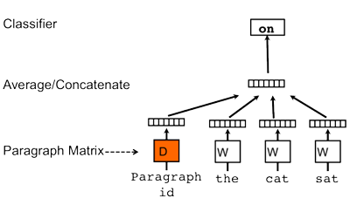
DOC2VEC

Slide 35
DOC2VEC
The doc2vec models may be used in the following way:
For training, a set of documents is required.
So, when training the word vectors W, the document vector D is trained as well, and in the end of training, it holds a numeric representation of the document.
A word vector W is generated for each word.
A document vector D is generated for each document.
The model also trains weights for a softmax hidden layer.
In the inference stage, a new document may be presented, and all weights are fixed to calculate the document vector.

Slide 36

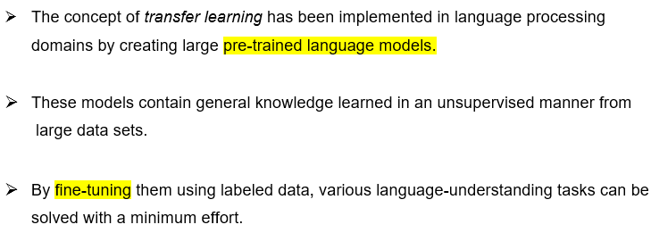

Slide 37
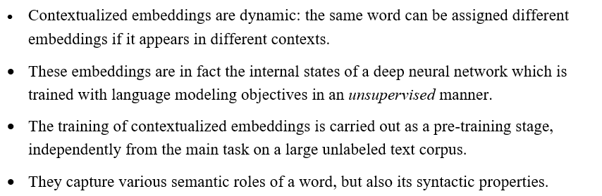
Contextualized word embeddings

Slide 38
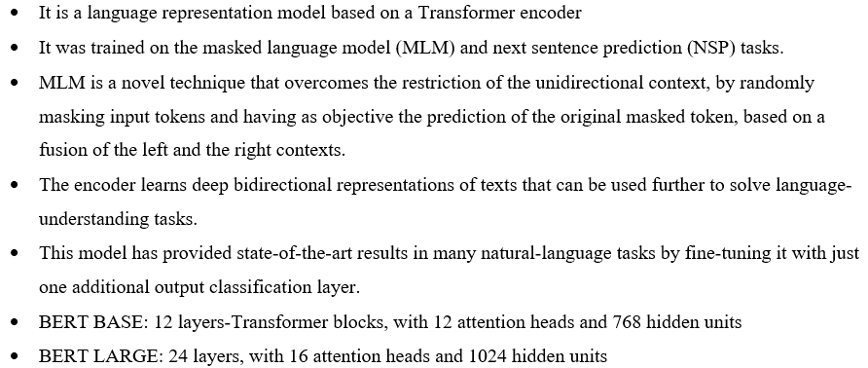
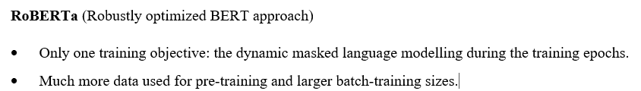
BERT (BIDIRECTIONAL ENCODER REPRESENTATIONS FROM TRANSFORMERS)

Slide 39
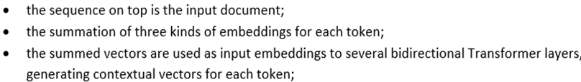
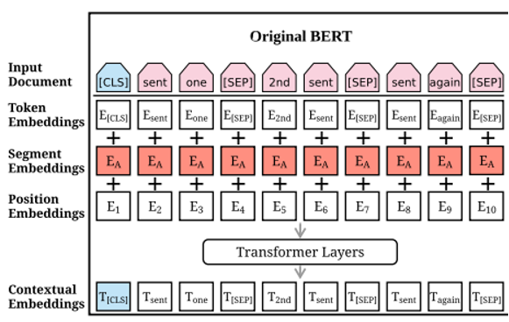
BERT MODEL

Slide 40
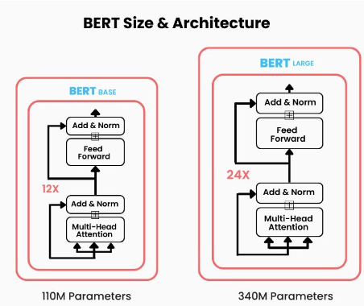
BERT – Transformer model

Slide 41
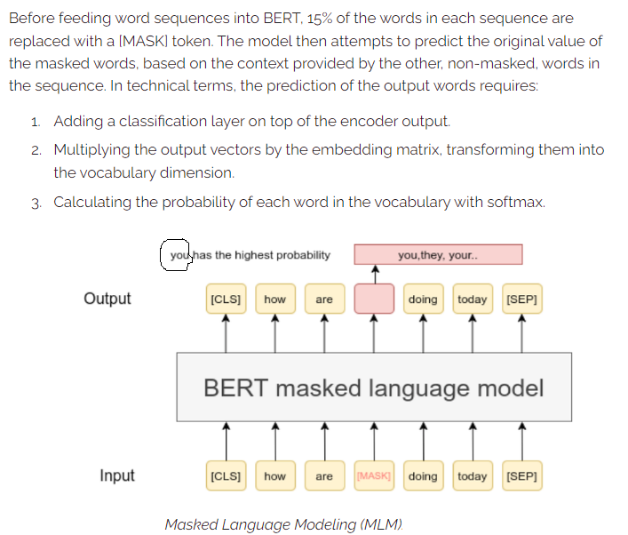
MASKED LANGUAGE MODELLING

Slide 42
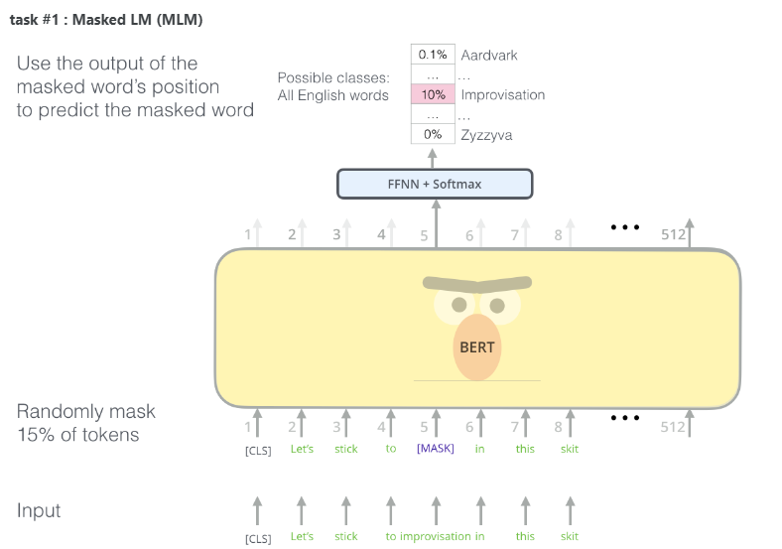

Slide 43


Slide 44

COMPARISON: BERT – ROBERTA - XLNET - DISTILBERT

Slide 45

BERTS FOR ROMANIAN LANGUAGE
RoBERT
https://github.com/dumitrescustefan/Romanian-Transformers
Romanian DistilBERT: https://github.com/racai-ai/Romanian-DistilBERT

